Slide 1
1587: COMMUNICATION SYSTEMS 1 Internet Protocols
Dr. George Loukas
University of Greenwich, 2015-2016

Slide 2
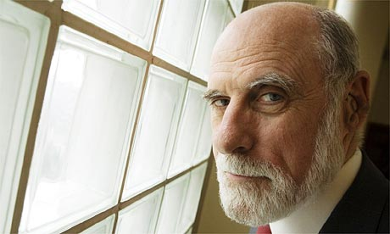
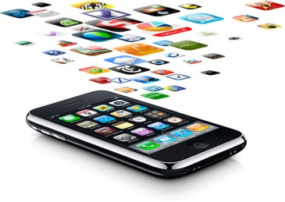





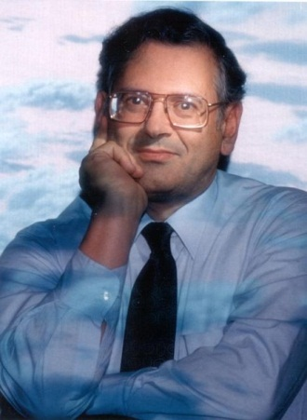
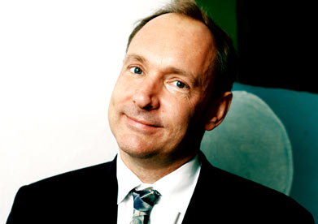
Internet
One of the most impressive success stories in science and technology
Yet, it is still based on the old IP, the TCP etc…
Notes:
Vint Cerf: The Internet was not supposed to be THE Internet. When they designed it, it was supposed to be an experiment. They would take their measurements and they would then decide how to develop it properly.
But by its own nature, the internet expanded rapidly because people found it useful. So, it expanded to the point that it now covers the whole world and every aspect of our life. So, it never made that transition from an experiment to a real, well-though-out product. The result of this is that we are still using the IP and the TCP almost exactly as they were 30 years ago.
TCP is utilised extensively by many of the Internet's most popular applications, including the World Wide Web (WWW), E-mail, FTP and peer-to-peer.
400 million people spend half their day on facebook. The same for google.

Slide 3
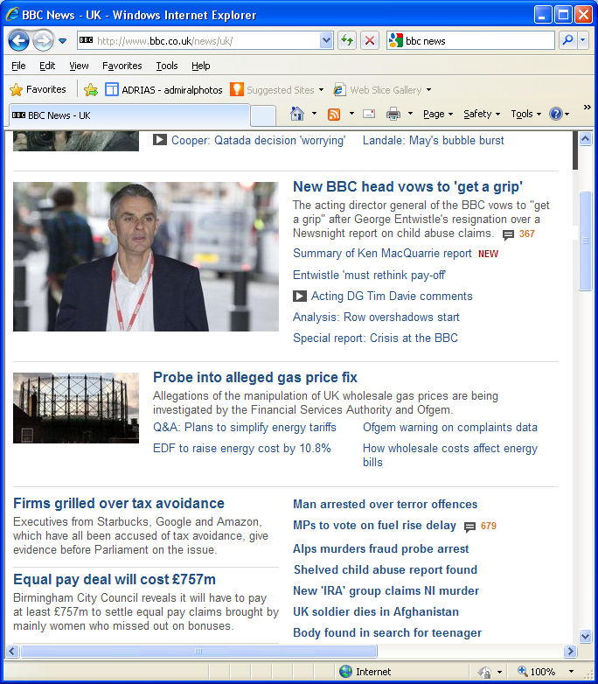
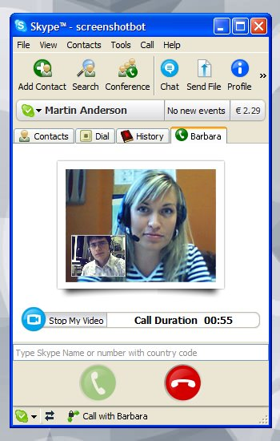
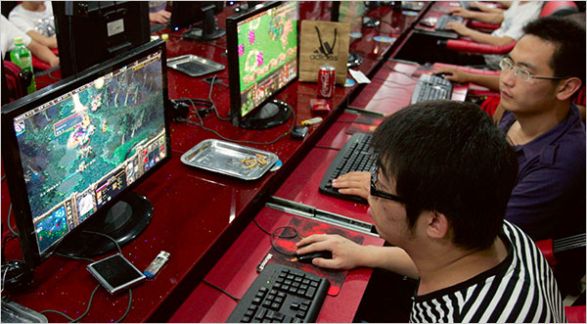
IP
213.78.99.152
118.234.25.17
16.124.15.117
151.52.199.223

Slide 4
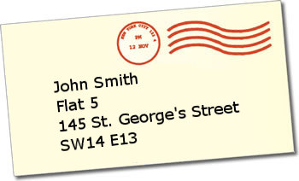
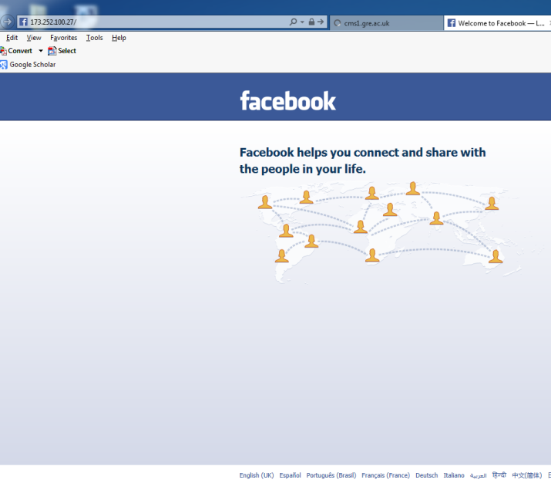
Domain Name System (DNS)
The IP address is the Internet equivalent of our physical address.
For example, if you type 31.13.90.36, your browser will take you to Facebook
31.13.90.3
but I doubt you ever had to do this.

Slide 5
Domain Name System (DNS)
www.facebook.com
That’s thanks to the DNS servers and their lists of addresses and IPs

Slide 6
Domain Name System (DNS)
Example:
root
nameserver
Where is www.facebook.com?
198.41.0.4
Try 204.75.123.1
.com
nameserver
204.75.123.1
User’s browser
Try 66.220.149.88
facebook.com
nameserver
66.220.149.88
It’s 31.13.90.3

Slide 7
Protocols
Protocols are the rules and procedures for computers to communicate
When a set of protocols works cooperatively, it is called a protocol stack or protocol suite
(e.g. TCP/IP is the Internet Protocol Suite)
They might work at one or many layers of the OSI
Notes:
For two computers to communicate, they must speak the same language and agree on the rules of communication

Slide 8
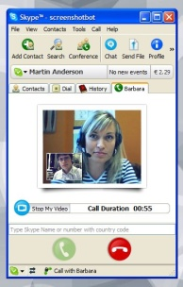
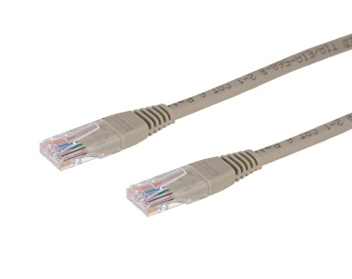
Open Systems Interconnection model
The OSI model
Application Layer
Provides programs with access to the network services
Presentation Layer
Ensures that data is readable by the receiving system. Handles encryption/decryption
data
Session Layer
Establishes, maintains, and coordinates communication between applications.
Transport Layer
Ensures reliable delivery of data. Breaks data into segments. Handles sequencing and acknowledgements and provides flow control
segments
Network Layer
Handles packet routing. Logical addressing, and access control through packet inspection
packets
Data Link Layer
Provides physical addressing, device-to-device delivery of frames, media access control, and MAC addresses
frames
Physical Layer
Manages hardware connection, Handles sending and receiving binary signals, Handles encoding of bits
bits
Notes:
OSI: The Open Systems Interconnection model
Different names for packets at different layers:
Ethernet (link layer) frame
IP (network layer) datagram
TCP (transport layer) segment
Terminology is not strictly followed
we often just use the term “packet” at any layer

Slide 9
Encapsulation
Application Layer
DATA
Presentation Layer
Session Layer
Transport Layer
DATA
Transport
Header
Network Layer
DATA
Transport
Header
IP
Header
Data Link Layer
DATA
Transport
Header
IP
Header
MAC
Header
Physical Layer

Slide 10


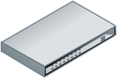
Blah blah blah ...
Blah blah blah…
Application Application
Transport Transport
Network Network Network
Datalink Datalink Datalink
Physical Physical Physical
10110010100010101
10110010100010101
Source node Intermediate Destination node node

Slide 11
IP routing
Routers direct the IP data packets through the network
by:
Making routing decisions based on the packet’s destination address and one or more routing criteria (min. hop, min. delay etc.)
Fragmenting the packets into smaller ones if they are too big
Deciding whether some packets need to be dropped because they are taking too long
Notes:
Networks have limits for the size of the data portion of packets
If a large packet needs to traverse a network, it may need to be fragmented to smaller ones

Slide 12
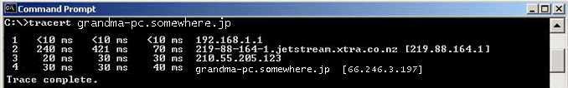

traceroute (unix) / tracert (windows)
219.88.164.1
192.168.1.1
66.246.3.197
210.55.205.123
Notes:
Networks have limits for the size of the data portion of packets
If a large packet needs to traverse a network, it may need to be fragmented to smaller ones

Slide 13



IP routing: IP header
To help the routers do their job,
an IP header is added at the network layer
Network Layer
DATA
Transport
Header
IP
Header
0
15
16
31
vers hlen TOS total length (in bytes)
identification flags fragment offset
TTL protocol header checksum
Source IP address
Destination IP address
options and padding
Notes:
Version - 4 bits Version of the IP protocol. Current version is 4
Internet Header Length - 4 bits For easy finding of beginning of data
Type Of Service - 8 bits The first of 3 bits are used to indicate 1 of 8 levels of priority Some Routers ignore these flags
Total length - 16 bits The total length of the IP datagram in bytes The size of data is computed from the total length field and IHL
Identification - 16 bits This is an integer value used to help identify all fragments of a datagram This field is unique for each new datagram
Flags - 3 bits The 2 low order bits are used as flags to control fragmentation The low order bit , if 0 , indicates the last fragment of a datagram - MF (More Flag) The middle bit is used to indicate that the datagram should not be fragmented - DF (Do not Fragment)
Fragment Offset - 13 bits Used in a fragmented datagram to indicate the position that the fragment occupies
Time To Live (TTL) - 8 bits Specifies how long the datagram is allowed to “live” on the network, in terms of router hops. Each router decrements the value of the TTL field (reduces it by one) prior to transmitting it. If the TTL field drops to zero, the datagram is assumed to have taken too long a route and is discarded This prevents datagrams to get routed in a loop The recommended value is 32 , but it can be set to a maximum of 255 too
Protocol - 8 bits The transport layer protocol carried by this datagram . It tells the IP layer where to path the datagram 17 - UDP 6 - TCP 1 - ICMP
Header checksum - 16 bits Basic protection against corruption in transmission It protects only the header and not the data The reason is that the checksum must be recalculated every time it passes through a router
Source IP address - 32 bits
Destination IP address - 32 bits

Slide 14
IP: Summary
Network layer protocol
Routing packets across the network
Unreliable
Best effort delivery
Recovery from lost packets must be done at higher layers
Connectionless
Packets are delivered (routed) independently
Can be delivered out of order; re-sequencing must be done at higher layers

Slide 15
The problems with IPv4
Hasn’t changed since 1981, but our needs have changed.
Security
Quality of Service
Speed
Too complicated
It takes time to setup a simple IP network and routing is more complex than it needs to be
and there are only 2³² (~4 billion) addresses
We are running out of addresses

Slide 16
IPv6
128 bits
0011111111111110. 0001100100000000. 0100010101000101.00000000000000011.0000001000000000.1111100011111111.1111111000100001.0110011111001111

Slide 17
IPv6 Vs. IPv4: Comparing packet headers
0
15
16
31
vers hlen TOS total length
No option field: Replaced by extension header. Results in a fixed length, 40-byte IP header.
No header checksum: Results in faster processing.
No fragmentation at intermediate nodes: Results in faster IP forwarding.
identification flags flag-offset
20
bytes
TTL protocol header checksum
source address
destination address
options and padding
IPv4
vers traffic class flow-label
payload length next header hop limit
40
bytes
source address
destination address
IPv6

Slide 18
Transport Control Protocol
The IP is the most widespread network protocol thanks to:
simple design
ability to connect almost all kinds of networks
But it does not address errors and does not create end-to-end connections.
That’s what the TCP protocol is for.
It streams data traffic by establishing end-to-end connections
It turns an unreliable network into a reliable one, free from packet losses, errors, congestion and duplications.

Slide 19
TCP: Basic operation
At sender
Break application data into TCP segments
Retransmit non-ACK’d packets (window-based flow control with timer)
Slow down if network can’t cope
At receiver
Detect errors, lost, out of sequence, duplicated packets
Acknowledge correctly received data
Reassemble segments into their proper order
Discard duplicate segments
Notes:
At sender
Break application data into TCP segments
Use a timer while waiting for an ACK of every packet
Non-ACK’d packets are retransmitted (window-based flow control)
Slow down if network can’t cope
At receiver
Detect errors, lost, out of sequence, duplicated packets
Acknowledge correctly received data
Segments are reassembled into their proper order
Duplicate segments are discarded

Slide 20
TCP header
To help TCP do its job,
A TCP header is added at the transport layer
TCP SEGMENT
Transport Layer
DATA
Transport
Header
SOURCE PORT
DESTINATION PORT
SEQUENCE NUMBER
ACK NUMBER
Hlen
Reserved
FLAGS
WINDOW
CHECKSUM
URGENT POINTER
TCP OPTIONS
Notes:
Source port (16 bits) – identifies the sending port
Destination port (16 bits) – identifies the receiving port
Sequence number (32 bits) – has a dual role: For normal transmissions, the sequence number of the first byte of data in this segment. In a connection request (SYN) message, this carries the initial sequence number (ISN) of the source TCP.
Acknowledgment number (32 bits) – if the ACK flag is set then the value of this field is the next sequence number that the receiver is expecting. This acknowledges receipt of all prior bytes (if any).
Data offset (4 bits) – specifies the size of the TCP header in 32-bit words. The minimum size header is 5 words and the maximum is 15 words thus giving the minimum size of 20 bytes and maximum of 60 bytes, allowing for up to 40 bytes of options in the header. This field gets its name from the fact that it is also the offset from the start of the TCP segment to the actual data.
Reserved (4 bits) – for future use and should be set to zero
Flags (8 bits) (aka Control bits) – contains 8 1-bit flags
Window size (16 bits) – the size of the receive window, which specifies the number of bytes (beyond the sequence number in the acknowledgment field) that the receiver is currently willing to receive
Checksum (16 bits) – The 16-bit checksum field is used for error-checking of the header and data
Urgent pointer (16 bits) – if the URG flag is set, then this 16-bit field is an offset from the sequence number indicating the last urgent data byte
Options (Variable 0-320 bits, divisible by 32) – The length of this field is determined by the data offset field. Options 0 and 1 are a single byte (8 bits) in length. The remaining options indicate the total length of the option (expressed in bytes) in the second byte
Padding - If the Options field is not a multiple of 32 bits in length, enough zeroes are added to pad the header so it is a multiple of 32 bits.

Slide 21
TCP: Connection Establishment
SOURCE PORT
DESTINATION PORT
Flags
SEQUENCE NUMBER
URG
ACK NUMBER
ACK
Hlen
Reserved
FLAGS
WINDOW
PSH
CHECKSUM
URGENT POINTER
RST
TCP OPTIONS
SYN
3-way handshake
Client - Port: 930
FIN
Server – Port: 745
SYN
My SEQ No = 200
SYN SENT
CLOSED
SYN-RCVD
LISTEN
ACK
My SEQ =500
Your SEQ = 201
ACK
My SEQ =201
Your SEQ = 501
ESTABLISHED
ESTABLISHED

Slide 22
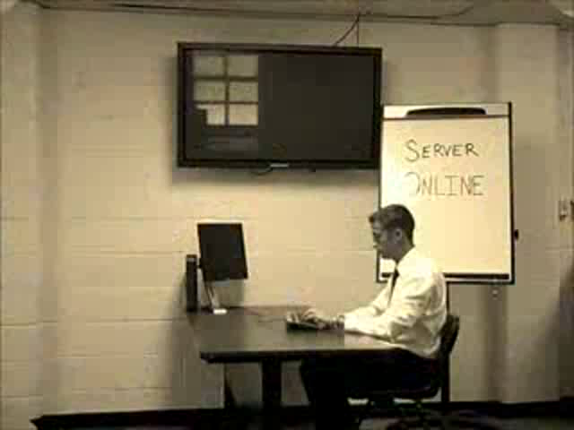

SYN flood
New York ISP & NY Times
Massachusetts Businessman
IRC
1996
1997
2004

Slide 23
UDP: User Datagram Protocol
Like TCP, also in the Transport Layer
Connectionless delivery service (no handshaking between sender and receiver, each segment is handled indepedently)
Unreliable (best-effort, UDP segments may be lost, delivered out of order)
Small header
Simple
Fast (no connection establishment, no congestion control)
Transport Layer
DATA
Transport
Header
IP
Header
0
16
31
Source Port Destination Port
Message Length
checksum
Notes:
No connection establishment.... packets can show up at any time.... the App has to handle whether you are prepared for the incoming data or not...
Datagram.... means UDP packets are self contained no sequencing like in TCP
Unreliable like IP, no ACKs... no flow control, no automatic retransmission...
Adds checksumming the headers.... to prevent errors... Adds application multiplexing, to send the UDP packet to the correct service. Both TCP and UDP perform this demultiplexing, and they use port numbers to do it....
Some massively multiplayer online games use TCP
That meant a lot of game developers had to implement their own reliability layer on top of UDP, or they used UDP for messages that could be dropped or received out of order, and used a parallel TCP connection for information that must be reliable. In the past, it was almost impossible due to low speeds and less reliable physical infrastructure. Now, TCP can be used, but is still not preferable. TCP can overcome most such limitations with clever algorithms, but in general it is designed for reliability, not swift real-time interaction.
Non-realtime aspects of a game may be using TCP
Flash doesn’t support UDP. So, you are normally limited to TCP.
World of Warcraft uses TCP. Halo uses UDP.

Slide 24
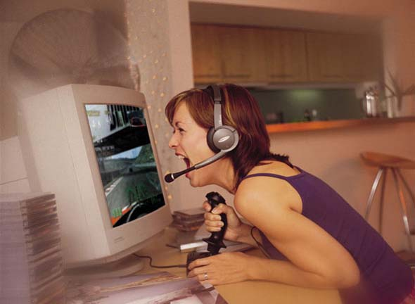
TCP Vs. UDP
Notes:
TCP is often not used where the real-time requirement is very important
If packets are lost in TCP, everything must stop and wait for the packets to be retransmitted.
TCP connections over dialup/ISDN/slow broadband resulted in choppy, laggy games because a single dropped packet resulted in a resync.
Although one player may still be moving, the other players may see that player standing still (until they receive the new packet)
TCP can overcome most such limitations with clever algorithms, but in general it is designed for reliability, not swift real-time interaction.
Some massively multiplayer online games use TCP
That meant a lot of game developers had to implement their own reliability layer on top of UDP, or they used UDP for messages that could be dropped or received out of order, and used a parallel TCP connection for information that must be reliable. In the past, it was almost impossible due to low speeds and less reliable physical infrastructure. Now, TCP can be used, but is still not preferable. TCP can overcome most such limitations with clever algorithms, but in general it is designed for reliability, not swift real-time interaction.
Non-realtime aspects of a game may be using TCP
Flash doesn’t support UDP. So, you are normally limited to TCP.
World of Warcraft uses TCP. Halo uses UDP.

Slide 25
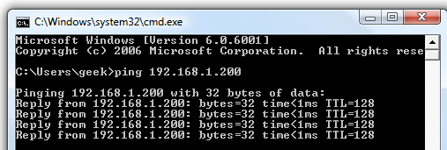
ICMP: Internet Control Message Protocol
Used by routers and nodes
Performs error reporting for the IP
ICMP messages contain:
Type
Code (subtype)
Checksum
+ other info depending on type and code
Some examples of ICMP messages
Type | Code | Message
0 | 0 | Echo Reply
3 | 1 | Destination host unreachable
3 | 4 | Fragmentation required
5 | 1 | Redirect message for the host
8 | 0 | Echo Request
11 | 0 | TTL expired in transit

Slide 26

5 minutes

Slide 27
Bits revision
In this presentation, where I have an x, I mean a bit that can be either 0 or 1
x
How many numbers can you represent with 1 bit?
2¹=2
(0 or 1)
xx
... with 2 bits?
2²=4
(0, 1, 2, 3)
xxx
... with 3 bits?
2³=8
(0, 1, 2, ..., 7)
xxxx
... with 4 bits?
2⁴=16
(0, 1, 2, ..., 15)
xxxxx
... with 5 bits?
2⁵=32
(0, 1, 2, ..., 31)
xxxxxxxx
... with 8 bits?
2⁸=256
(0, 1, 2, ..., 255)

Slide 28
Binary to Decimal
11111111
128
+ 64
+ 32
+ 16
+ 8
+ 4
+ 2
+ 1
= 255
10011001
128
+ 64
+ 32
+ 16
+ 8
+ 4
+ 2
+ 1
= 153

Slide 29
Binary to Decimal
11111111
= 255
128 + 64 +32 +16+ 8 + 4 + 2 + 1
00000000
= 0
00000001
= 1
00000010
= 2
00000011
= 3
00000110
= 6

Slide 30
Binary to Decimal
11111111
= 255
128 + 64 +32 +16+ 8 + 4 + 2 + 1
00100000
= 32
00100001
= 33
10000000
= 128
11000000
= 192
11111111
= 255

Slide 31
Decimal to Binary
1
0
1
0
0
1
1
0
166 =
128 + 64 +32 +16+ 8 + 4 + 2 + 1
164
160
166
0
1
1
1
1
0
1
1
123 =
128 + 64 +32 +16+ 8 + 4 + 2 + 1
96
112
120
122
123

Slide 32
IP
32 bits
00010000.01111100.00001111.01110101
16.124.15.117
Class A: 1 to 126
0xxxxxxx.xxxxxxxx.xxxxxxxx.xxxxxxxx
Class B: 128 to 191
10xxxxxx.xxxxxxxx.xxxxxxxx.xxxxxxxx
Class C: 192 to 223
110xxxxx.xxxxxxxx.xxxxxxxx.xxxxxxxx
Class D: 224 to 239
1110xxxx.xxxxxxxx.xxxxxxxx.xxxxxxxx
Class E: 240 to 254
1111xxxx.xxxxxxxx.xxxxxxxx.xxxxxxxx

Slide 33
IP
NETID
HOSTID
Class A: 1 to 126
0xxxxxxx.xxxxxxxx.xxxxxxxx.xxxxxxxx
Large networks
NETID
HOSTID
Class B: 128 to 191
10xxxxxx.xxxxxxxx.xxxxxxxx.xxxxxxxx
Medium-sized networks
NETID
HOSTID
Class C: 192 to 223
110xxxxx.xxxxxxxx.xxxxxxxx.xxxxxxxx
Small networks
Class D: 224 to 239
1110xxxx.xxxxxxxx.xxxxxxxx.xxxxxxxx
Multicasting
Class E: 240 to 254
1111xxxx.xxxxxxxx.xxxxxxxx.xxxxxxxx
Experimental; often used in research

Slide 34
IP
Class A: 1 to 126
0xxxxxxx.xxxxxxxx.xxxxxxxx.xxxxxxxx
Class B: 128 to 191
10xxxxxx.xxxxxxxx.xxxxxxxx.xxxxxxxx
Class C: 192 to 223
110xxxxx.xxxxxxxx.xxxxxxxx.xxxxxxxx
Class D: 224 to 239
1110xxxx.xxxxxxxx.xxxxxxxx.xxxxxxxx
Class E: 240 to 254
1111xxxx.xxxxxxxx.xxxxxxxx.xxxxxxxx
124.113.14.23 is class ...
A
193.60.68.103 is class ...
C
What class is this IP?
191.112.212.0 is class ...
B
11000101.11111101.0101000.00011011 is class ...
C
01100001.00111101.1111001.11011011 is class ...
A

Slide 35
IP
Special IP addresses
127.0.0.1
Loopback address (myself)
255.255.255.255
Limited broadcast (in a LAN)
Private IP addresses
Class A: 10.0.0.0 to 10.255.255.255
Class B: 172.16.0.0 to 172.31.255.255
Used only in private networks (e.g. LANs)
Class C: 192.168.0.0 to 192.168.255.255

Slide 36
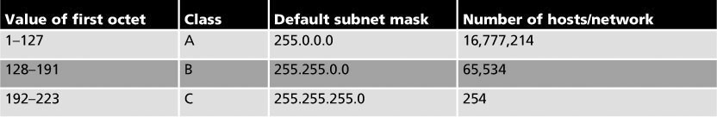
Subnet Masks
IP uses a subnet mask to determine which part of the address identifies the network portion and which part identifies the host portion
Subnet masks look like IPs (32 bits; a dot every 8 bits)
If a computer has
IP address 153.92.100.10 and the subnet mask is 255.255.0.0,
then the network portion is:
and the host portion is:
153.92.0.0
100.10

Slide 37
Common subnet masks
Net bits | Subnet Mask | (in binary) | Notes
/30 | 255.255.255.252 | 11111111.11111111.11111111.11111100 | 2 usable hosts
/29 | 255.255.255.248 | 11111111.11111111.11111111.11111000 | 6 usable hosts
/28 | 255.255.255.240 | 11111111.11111111.11111111.11110000 | 14 usable hosts
/27 | 255.255.255.224 | 11111111.11111111.11111111.11100000 | 30 usable hosts
/26 | 255.255.255.192 | 11111111.11111111.11111111.11000000 | 62 usable hosts
/25 | 255.255.255.128 | 11111111.11111111.11111111.10000000 | 126 usable hosts
/24 | 255.255.255.0 | 11111111.11111111.11111111.00000000 | CLASS C (254 usable hosts)
/23 | 255.255.254.0 | 11111111.11111111.11111110.00000000 | 2 Class C’s
/22 | 255.255.252.0 | 11111111.11111111.11111100.00000000 | 4 Class C’s
/21 | 255.255.248.0 | 11111111.11111111.11111000.00000000 | 8 Class C’s
/20 | 255.255.240.0 | 11111111.11111111.11110000.00000000 | 16 Class C’s
/19 | 255.255.224.0 | 11111111.11111111.11100000.00000000 | 32 Class C’s
/18 | 255.255.192.0 | 11111111.11111111.11000000.00000000 | 64 Class C’s
/17 | 255.255.128.0 | 11111111.11111111.10000000.00000000 | 128 Class C’s
/16 | 255.255.0.0 | 11111111.11111111.00000000.00000000 | CLASS B

Slide 38
Subnet Masks
logical
AND
1
AND
1
=
1
1
AND
0
=
0
0
AND
0
=
0
What is the network address of 144.124.15.117?
Class B. So, it must be 144.124.0.0
What is the network address of 144.124.15.117 / 22?
Net bits | Subnet Mask | (in binary)
/22 | (255.255.252.0) | 11111111.11111111.11111100.00000000
AND
(144.124.15.117)
10010000.01111100.00001111.01110101
Network address =
1
0
0
1
0
000.01111100.00001100.00000000
= 144.124.12.0
Notes:
To find the network address, we do a logical AND between the IP and the subnet mask.

Slide 39
Subnetting
By using more restrictive masks, a network can be divided in several subnets.
For example, for a class B network, the default mask is 255.255.0.0.
If we use 255.255.224.0 instead:
11111111.11111111.00000000.00000000
11111111.11111111.11100000.00000000
the additional 3 bits stolen from the host part allow us to use 8 subnets (000, 001, 010, 011, 100, 101, 110 and 111).
Generalising this, we can have 2^{n} subnets, where n is the number of bits added to the mask for subnetting.
And each subnet can have 2^{m} – 2 hosts, where m is the number of bits left
(the -2 is because the first address is always reserved for the subnet and the last address for broadcast.
Here: 2³ = 8 subnets and 2¹³ – 2 = 8,190 hosts per subnet.

Slide 40
Static subnetting example
How many subnets and hosts per subnet can you get from the network 174.20.0.0/255.255.255.240?
The default mask for a class B network is 255.255.0.0 (/16)
111111111.11111111.00000000.00000000
but this network’s mask is 255.255.255.240 (/28)
111111111.11111111.11111111.11110000
The additional 12 bits allow us 2¹² = 4,096 subnets.
The remaining 4 bits allows us 2⁴ – 2 = 14 hosts per subnet.

Slide 41
Static subnetting example (part 2)
Which subnets and hosts per subnet can you get from the network 174.20.0.0/255.255.255.240?
(255.255.255.240)
11111111.11111111.11111111.11110000
AND
(174.20.0.0)
10101110. 00010100.00000000.00000000
Network address =
10101110.00010100.00000000.00000000
174.20.0.0
First host of first Subnet =
10101110.00010100.00000000.00000001
174.20.0.1
Last host of first Subnet =
-
10101110.00010100.00000000.00001110
174.20.0.14
...
...
First host of last Subnet =
10101110.00010100.11111111.11110001
174.20.255.241
Last host of last Subnet =
-
10101110.00010100.11111111.11111110
174.20.255.254

Slide 42
Variable subnetting practice for the lab
25
5
4
Consider one central office with 25 workstations, one remote office with 4 and another remote office with 5 workstations. Divide its class C network into subnets.
Hint: Divide it based on the largest subnet needed, allocate the first subnet to the large office and then divide the second subnet to smaller ones.

Slide 43
Variable subnetting practice for the lab
25
5
4
Consider one central office with 25 workstations, one remote office with 4 and another remote office with 5 workstations. Divide its class C network into subnets.
Net bits | Subnet Mask | Notes
/30 | 255.255.255.252 | 2 usable hosts
/29 | 255.255.255.248 | 6 usable hosts
/28 | 255.255.255.240 | 14 usable hosts
/27 | 255.255.255.224 | 30 usable hosts
/26 | 255.255.255.192 | 62 usable hosts
/25 | 255.255.255.128 | 126 usable hosts
/24 | 255.255.255.0 | Class C
For the 25-station subnet, we need at least a /27 mask
For the other subnets, a /29 for each one will do.
SOLUTION
Net bits | Subnet Mask | (in binary) | Notes
/27 | 255.255.255.224 | 11111111.11111111.11111111.11100000 | Up to 8 subnets (30 hosts each)
/29 | 255.255.255.248 | 11111111.11111111.11111111.11111000 | Up to 32 subnets (6 hosts each)

Slide 44
Variable subnetting practice for the lab
25
5
4
Allocate the /27 subnets first
Fourth octet of the IP | Host Addresses | Allocate to:
.000xxxxx | from .01 to .30 | 25-station office
.001xxxxx | from .33 to .62 | Subnet this again
.010xxxxx | from .65 to .94 | Leave it unused
.011xxxxx | from .97 to ... | Leave it unused
.100xxxxx | ... | Leave it unused
.101xxxxx | ... | Leave it unused
.110xxxxx | ... | Leave it unused
.111xxxxx | … | Leave it unused
SOLUTION
Net bits | Subnet Mask | (in binary) | Notes
/27 | 255.255.255.224 | 11111111.11111111.11111111.11100000 | Up to 6 subnets (30 hosts each)
/29 | 255.255.255.248 | 11111111.11111111.11111111.11111000 | Up to 30 subnets (6 hosts each)

Slide 45
Variable subnetting practice for the lab
25
5
4
Now allocate the /29 subnets within the IP ranges of the second /27 subnet
Fourth octet of the IP | Host Addresses | Allocate to:
.000xxxxx | from .01 to .30 | 25-station office
.001xxxxx | from .33 to .62 | Subnet this again
Fourth octet of the IP | Host Addresses | Allocate to:
.00100xxx | from .33 to .38 | 5-station office
.00101xxx | from .41 to .46 | 4-station office
SOLUTION
Net bits | Subnet Mask | (in binary) | Notes
/27 | 255.255.255.224 | 11111111.11111111.11111111.11100000 | Up to 6 subnets (30 hosts each)
/29 | 255.255.255.248 | 11111111.11111111.11111111.11111000 | Up to 30 subnets (6 hosts each)

Slide 46
Binary to Hex
All this was for IPv4. In IPv6, the bits are just too many. So, instead of binary we work in Hex.
0000 =
Hex 0
0001 =
Hex 1
0010 =
Hex 2
0011 =
Hex 3
0001 1010 =
Hex 1A
1001 =
Hex 9
0001 1010 1110 1100 =
Hex 1A:EC
1010 =
Hex A
1011 =
Hex B
11111111 11111111 11111111 11111111 =
1100 =
Hex C
Hex FF:FF:FF:FF
1101 =
Hex D
1110 =
Hex E
Note that in Unix/Linux, subnet masks are shown in Hex
1111 =
Hex F

Slide 47
IPv6
3ffe:1900:4545:3:200:f8ff:fe21:67cf
128 bits
0011111111111110. 0001100100000000. 0100010101000101.00000000000000011.0000001000000000.1111100011111111.1111111000100001.0110011111001111

